Slide 1

Spam Detection
PIP2001 Capstone Project
Review-1
Batch Number:CSE-200
Under the Supervision of,
Dr. Chandra Sekhar M
Professor,
School of Computer Science & Engineering
Presidency University
Roll Number | Student Name
20211CSE0196 | Eshaan Khurana
20211CSE0230 | Charan Kumar S
20211CSE0550 | Gagana Sindu B M
20211CSE0140 | Hisham

Slide 2
Introduction
Spam Detection:
A critical component in modern communication systems.To protect the user from various cybercrimes, i.e. Phishing or Malware.It plays a vital role in maintaining the efficiency, security, and overall integrity of communication systems, particularly in email, social media, and messaging platforms.

Slide 3
Literature Review
Current Status: Literature review is in progress.
Objective: To gather insights and best practices for integrating AI into spam detection.

Slide 4
Proposed Method
Graph-Based Spam Detection for Sender Behavior Analysis:
Use graph-based models to analyze communication patterns between senders and recipients.
2. Context-Aware Spam Detection Using NLP and Sentiment Analysis:
Implement context-aware spam detection by integrating natural language processing (NLP)
techniques such as sentiment analysis, topic modeling, and contextual embeddings (e.g., BERT, GPT) to better understand the intent behind a message.
3. Multimodal Spam Detection:
Develop a multimodal spam detection system that combines different data modalities (e.g., text, images, attachments, and links). This method integrates image recognition for detecting malicious images, URL analysis for suspicious links, and text analysis for detecting spam content.

Slide 5
Objectives
Improve Detection Accuracy and Reduce False Positives/Negatives
Adapt to Evolving Spam Techniques
Leverage Multimodal Data for Comprehensive Detection
Continuous Monitoring and Feedback Integration

Slide 6
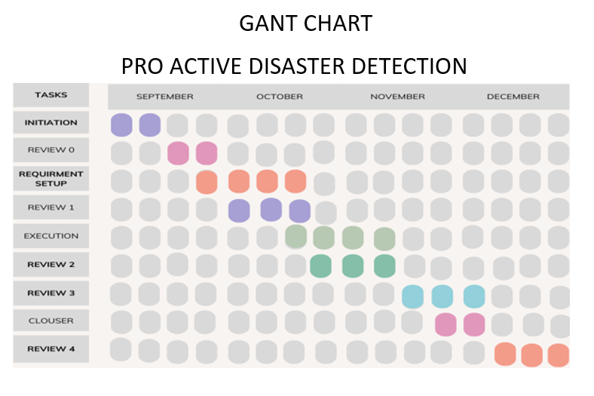
Timeline of Project

Slide 7
Expected Outcomes
Increased Detection Accuracy and Precision
Enhanced Adaptability to Evolving Spam Tactics
Improved Detection of Multimodal Spam
Continual Learning and Reduced Need for Manual Updates

Slide 8

Reference
Francisco Jáñez-Martino, Rocío Alaiz-Rodríguez, Víctor González-Castro, Eduardo Fidalgo & Enrique Alegre (2022). Handling Concept Drift in Spam Detection
Mohammad Tubishat Feras Al-Obeidat Ali Safaa Sadiq Seyedali Mirjalili (2023) . Improved Dandelion Optimizer Algorithm for Spam Detection: Next-Generation Email Filtering System.
Konstantinos I. Roumeliotis Nikolaos D. Tselikas and Dimitrios K. Nasiopoulos (2024). Fine-Tuning Large Language Models (LLMs) for Spam Filtering
Thashina Sultana, K A Sapnaz, Fathima Sana, Mrs. Jamedar Najath (2020). Email based Spam Detection

Slide 9

Conclusion
An improved and efficient version of spam detection presented infront of the world.Using various AI and ML methods to make an updated and better version of the spam detection software which is currently present on the internet.

Slide 10
GITHUB LINK
https://github.com/Delhiwala/Capstone-Project

Slide 11
Thank You

